Slide 1

Government Engineering College, Raipur(C.G)
Department of Electronics & Telecommunication Engineering
Project:
Fabrication and Characterization of 2D-SnS
Nano-Material Based Photo-Detector
Guided by :
Mr. Ravi Kumar (Asst. Professor)
Department Of Electronics & Telecommunication Engineering
Presented By:
Priyanshu Soni (301602821004)
Maan Jain (301602821012)
Omkar Nishad (301602821029)

Slide 2
Acknowledgement
We would like to express our sincere gratitude to the following institutions and mentors for their invaluable support and guidance throughout this project:
Indian Institute of Technology (IIT) Bhilai Department of Electronics and Communication Engineering Prof. Dr. Nikhil Chander – for providing technical insights, laboratory support, and continuous encouragement.
Pt. Ravishankar Shukla University, Raipur Department of Chemistry Prof. Dr. Kamlesh Shrivas – for providing chemical preparation expertise and guidance in material synthesis.

Slide 3
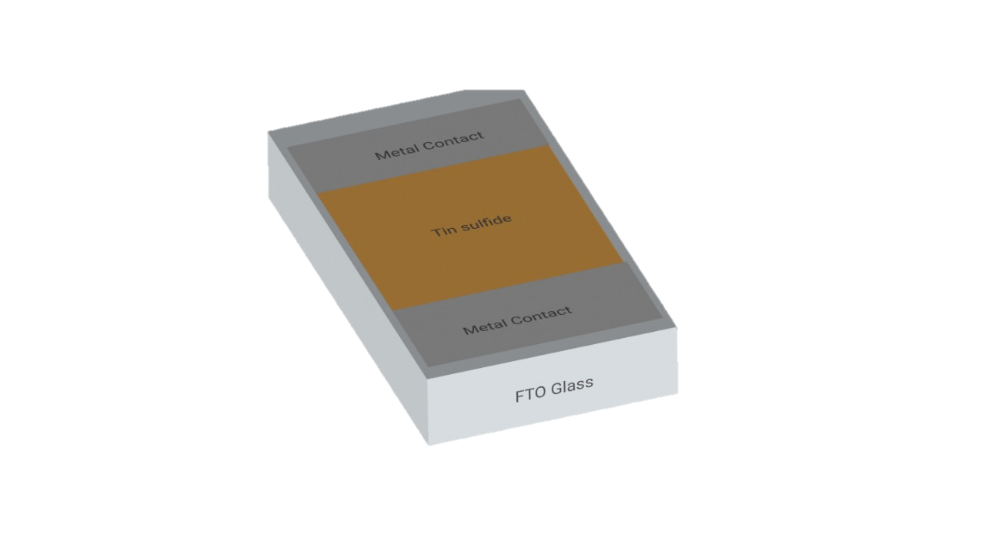
Introduction
This presentation focuses on the fabrication and performance analysis of a photodetector device. The device is built using SnS-coated FTO glass as the active layer and silver (Ag) as the electrode. We evaluate its performance using key parameters such as External Quantum Efficiency (EQE), Responsivity, response to monochromatic light, and I-V characteristics. The main objective is to understand how the fabrication process affects the efficiency and photoresponse of the device.

Slide 4
Why SnS ?
It has a suitable bandgap (~1.3 eV) ideal for visible light detection.
The absorption range of SnS spans from 1.2 eV to 3.5 eV, covering visible and IR regions.
Exhibits high absorption efficiency, enabling effective photon capture.
Provides excellent charge separation capabilities, enhancing photocurrent generation.
Known for strong photoconductivity, which improves detector sensitivity.
Offers environmental safety—SnS is non-toxic and eco-friendly.
Involves low fabrication cost, suitable for large-scale and affordable production.

Slide 5
Fabrication & Characterization Process
Chemical preparation
Mixing chemicals
Ultrasonication
Coating substrate
Cleaning the FTO glass
Metal contact deposition
Create vacuum
Thermal evaporation
pH check
Spin coating
Oven drying
Characterization
XRD
EQE
SEM analysis
UV-Visible spectroscopy

Slide 6
Chemical Preparation

Slide 7

Trisodium Citrate
Thio-acetamide
Stannous Chloride
Tin Sulfide
Chemical preparation
To prepare the solution for synthesis, 0.1 M of Stannous Chloride (SnCl₂) and 0.15 M of Thioacetamide (C₂H₅NS) were used as the sources of Sn²⁺ and S²⁻ ions, respectively.
Additionally, 0.2 M of Trisodium Citrate (Na₃C₆H₅O₇) was added as a complexing agent to stabilize the solution.

Slide 8
Chemical preparation
In the present synthesis route, thioacetamide (C₂ H₅NS) serves as a slow-releasing sulfide ion source in an aqueous medium. Upon hydrolysis, thioacetamide yields hydrogen sulfide, which subsequently dissociates to generate sulfide ions (S²⁻) under mildly acidic to near-neutral conditions:
C₂H₅NS + H₂O → CH₃CONH₂ + H₂S
H₂S ⇌ HS⁻ + H⁺ ⇌ S²⁺ + 2H⁺
The resulting sulfide ions react with tin (II) ions (Sn²⁺), which are derived from stannous chloride (SnCl₂), leading to the formation of tin (II) sulfide (SnS) as a solid precipitate:
Sn²⁺ + S²⁻ → SnS ↓

Slide 9
Coating Substrate

Slide 10
Spin Coating on FTO Glass
Substrate cleaning
Clean the FTO glass thoroughly to remove contaminant
Solution Cleaning
Deposit SnS solution onto the substrate via spin coating
Intermediate heating
Heat the coated substrate to promote adhesion and layer stability.
Repeat Coating Cycle
Repeat steps to build up film thickness and 2–3 ensure uniform coverage
.
.
.

Slide 11
Thermal Evaporation

Slide 12
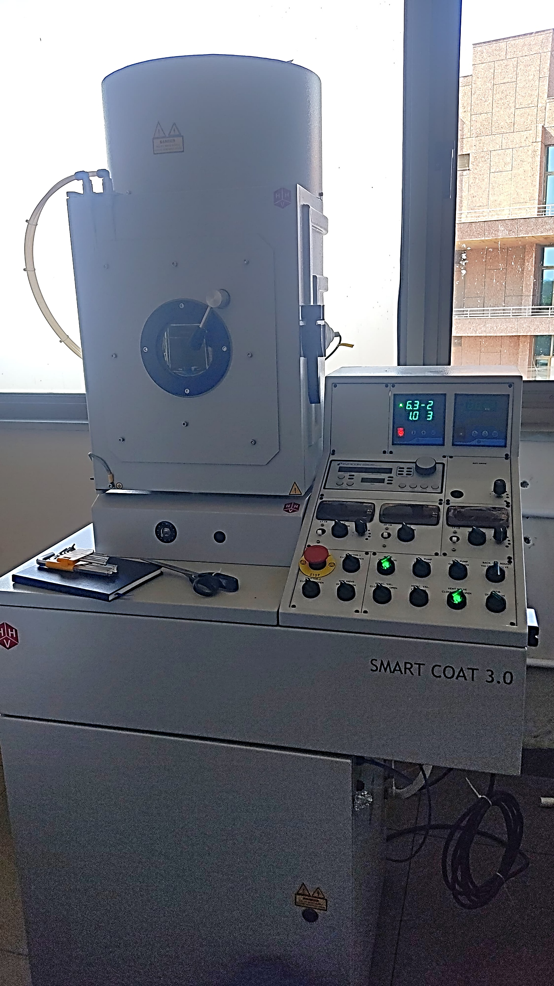
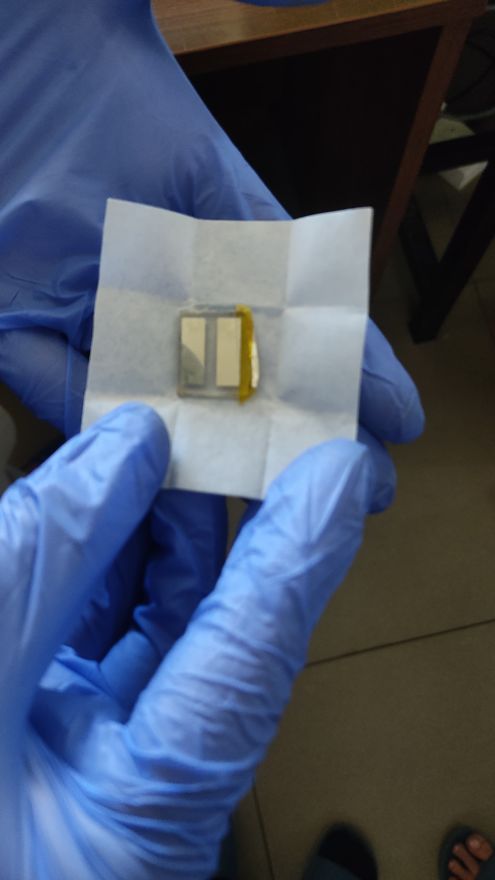
Thermal Evaporation
Silver (Ag) top contacts were deposited using thermal evaporation in a vacuum to ensure high-quality, oxidation-free films. This process parovides a low-resistance path for charge carriers. A uniform Ag–SnS interface is essential for optimal device performance.

Slide 13
Characterizations

Slide 14
Characterization Parameters
EQE (External Quantum Efficiency):
Measures how efficiently photons are converted to electrons.
Responsivity:
Indicates how much electrical output is produced per unit light power incident in it.
X-Ray Diffraction:
Analyzes the Crystaline property of the material extracted.
UV Visible Spectroscopy:
Analyzes the Crystaline property of the material extracted.
V-I Characteristics:
Helps determine electrical performance under illuminated and dark conditions.
SEM analysis:
SEM analyze the surface morphology and uniformity of the SnS film on the FTO.

Slide 15
UV-VISBLE SPECTROSCOPY GRAPH
This UV-Visible spectroscopy graph shows strong absorbance in the UV region (250–280 nm) with a rapid drop-off toward the visible range, indicating that the SnS photodetector material has high Absorbance in UV light and less so in the visible spectrum.

Slide 16
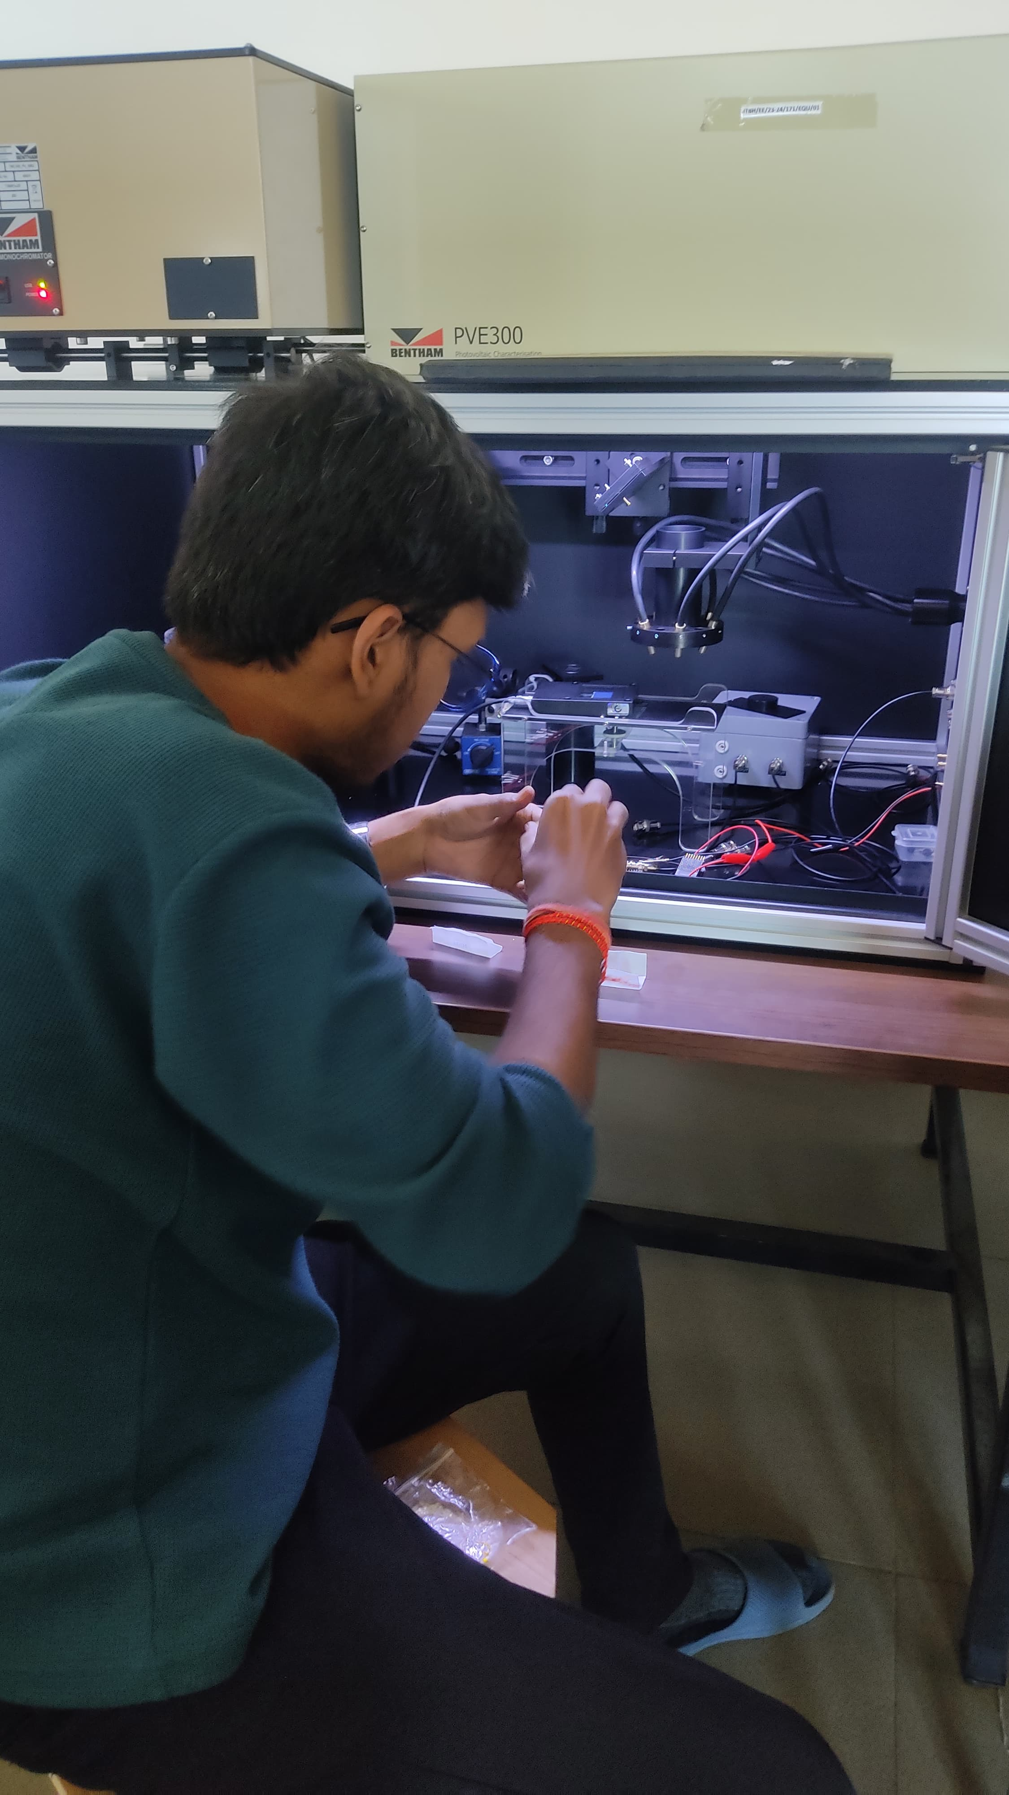
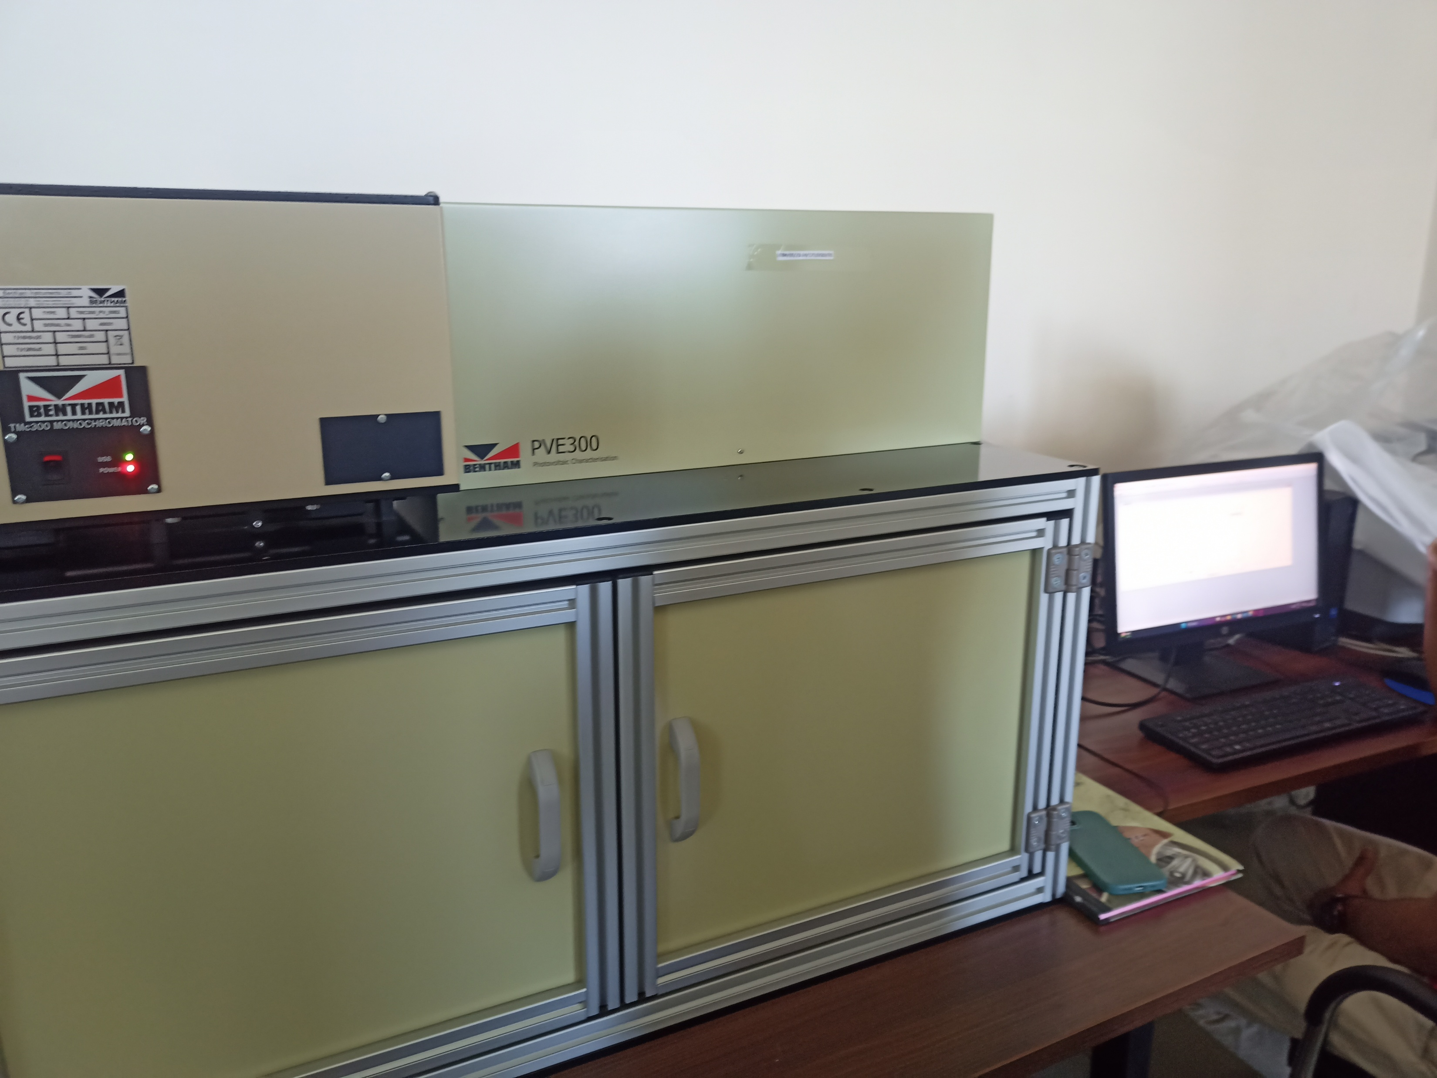
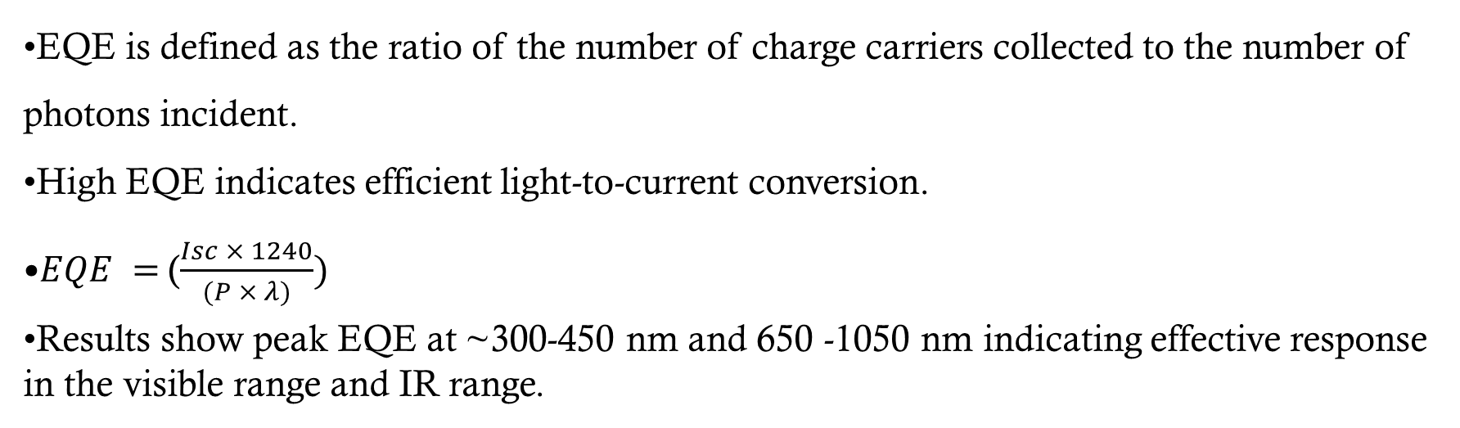
EQE Analysis
EQE is defined as the ratio of the number of charge carriers collected to the number of photons incident.
High EQE indicates efficient light-to-current conversion.
$EQE =$($\frac{Isc × 1240}{(P × λ)})$
Results show peak EQE at ~300-450 nm and 650 -1050 nm indicating effective response in the visible range and IR range.

Slide 17
EQE Analysis
The photodetector exhibits peak efficiency in the , Near-infrared (NIR) region (700-950 nm) to around 5%. This spectral response suggests the device with minimal response in the visible spectrum and a Nominal response in the NIR spectrum

Slide 18
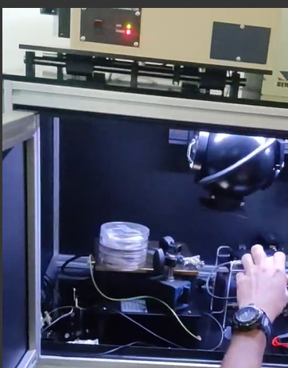
Responsivity Measurement
Responsivity (R) = I / P,
where I = current (A), P = incident power (W).
It defines the photodetector’s sensitivity to incoming light.
Units: A/W
Observed high responsivity values in the 400–600 nm range and IR range, confirming strong light absorption and photo-generation.

Slide 19
Responsivity Measurement
The responsivity curve shows two active regions: a UV peak (~0.17 A/W at 250–300 nm) and a second band starting at ~700 nm with stable responsivity (~0.05 A/W) in the 800–1000 nm near-infrared range, with a dip across the visible spectrum (300–600 nm).

Slide 20
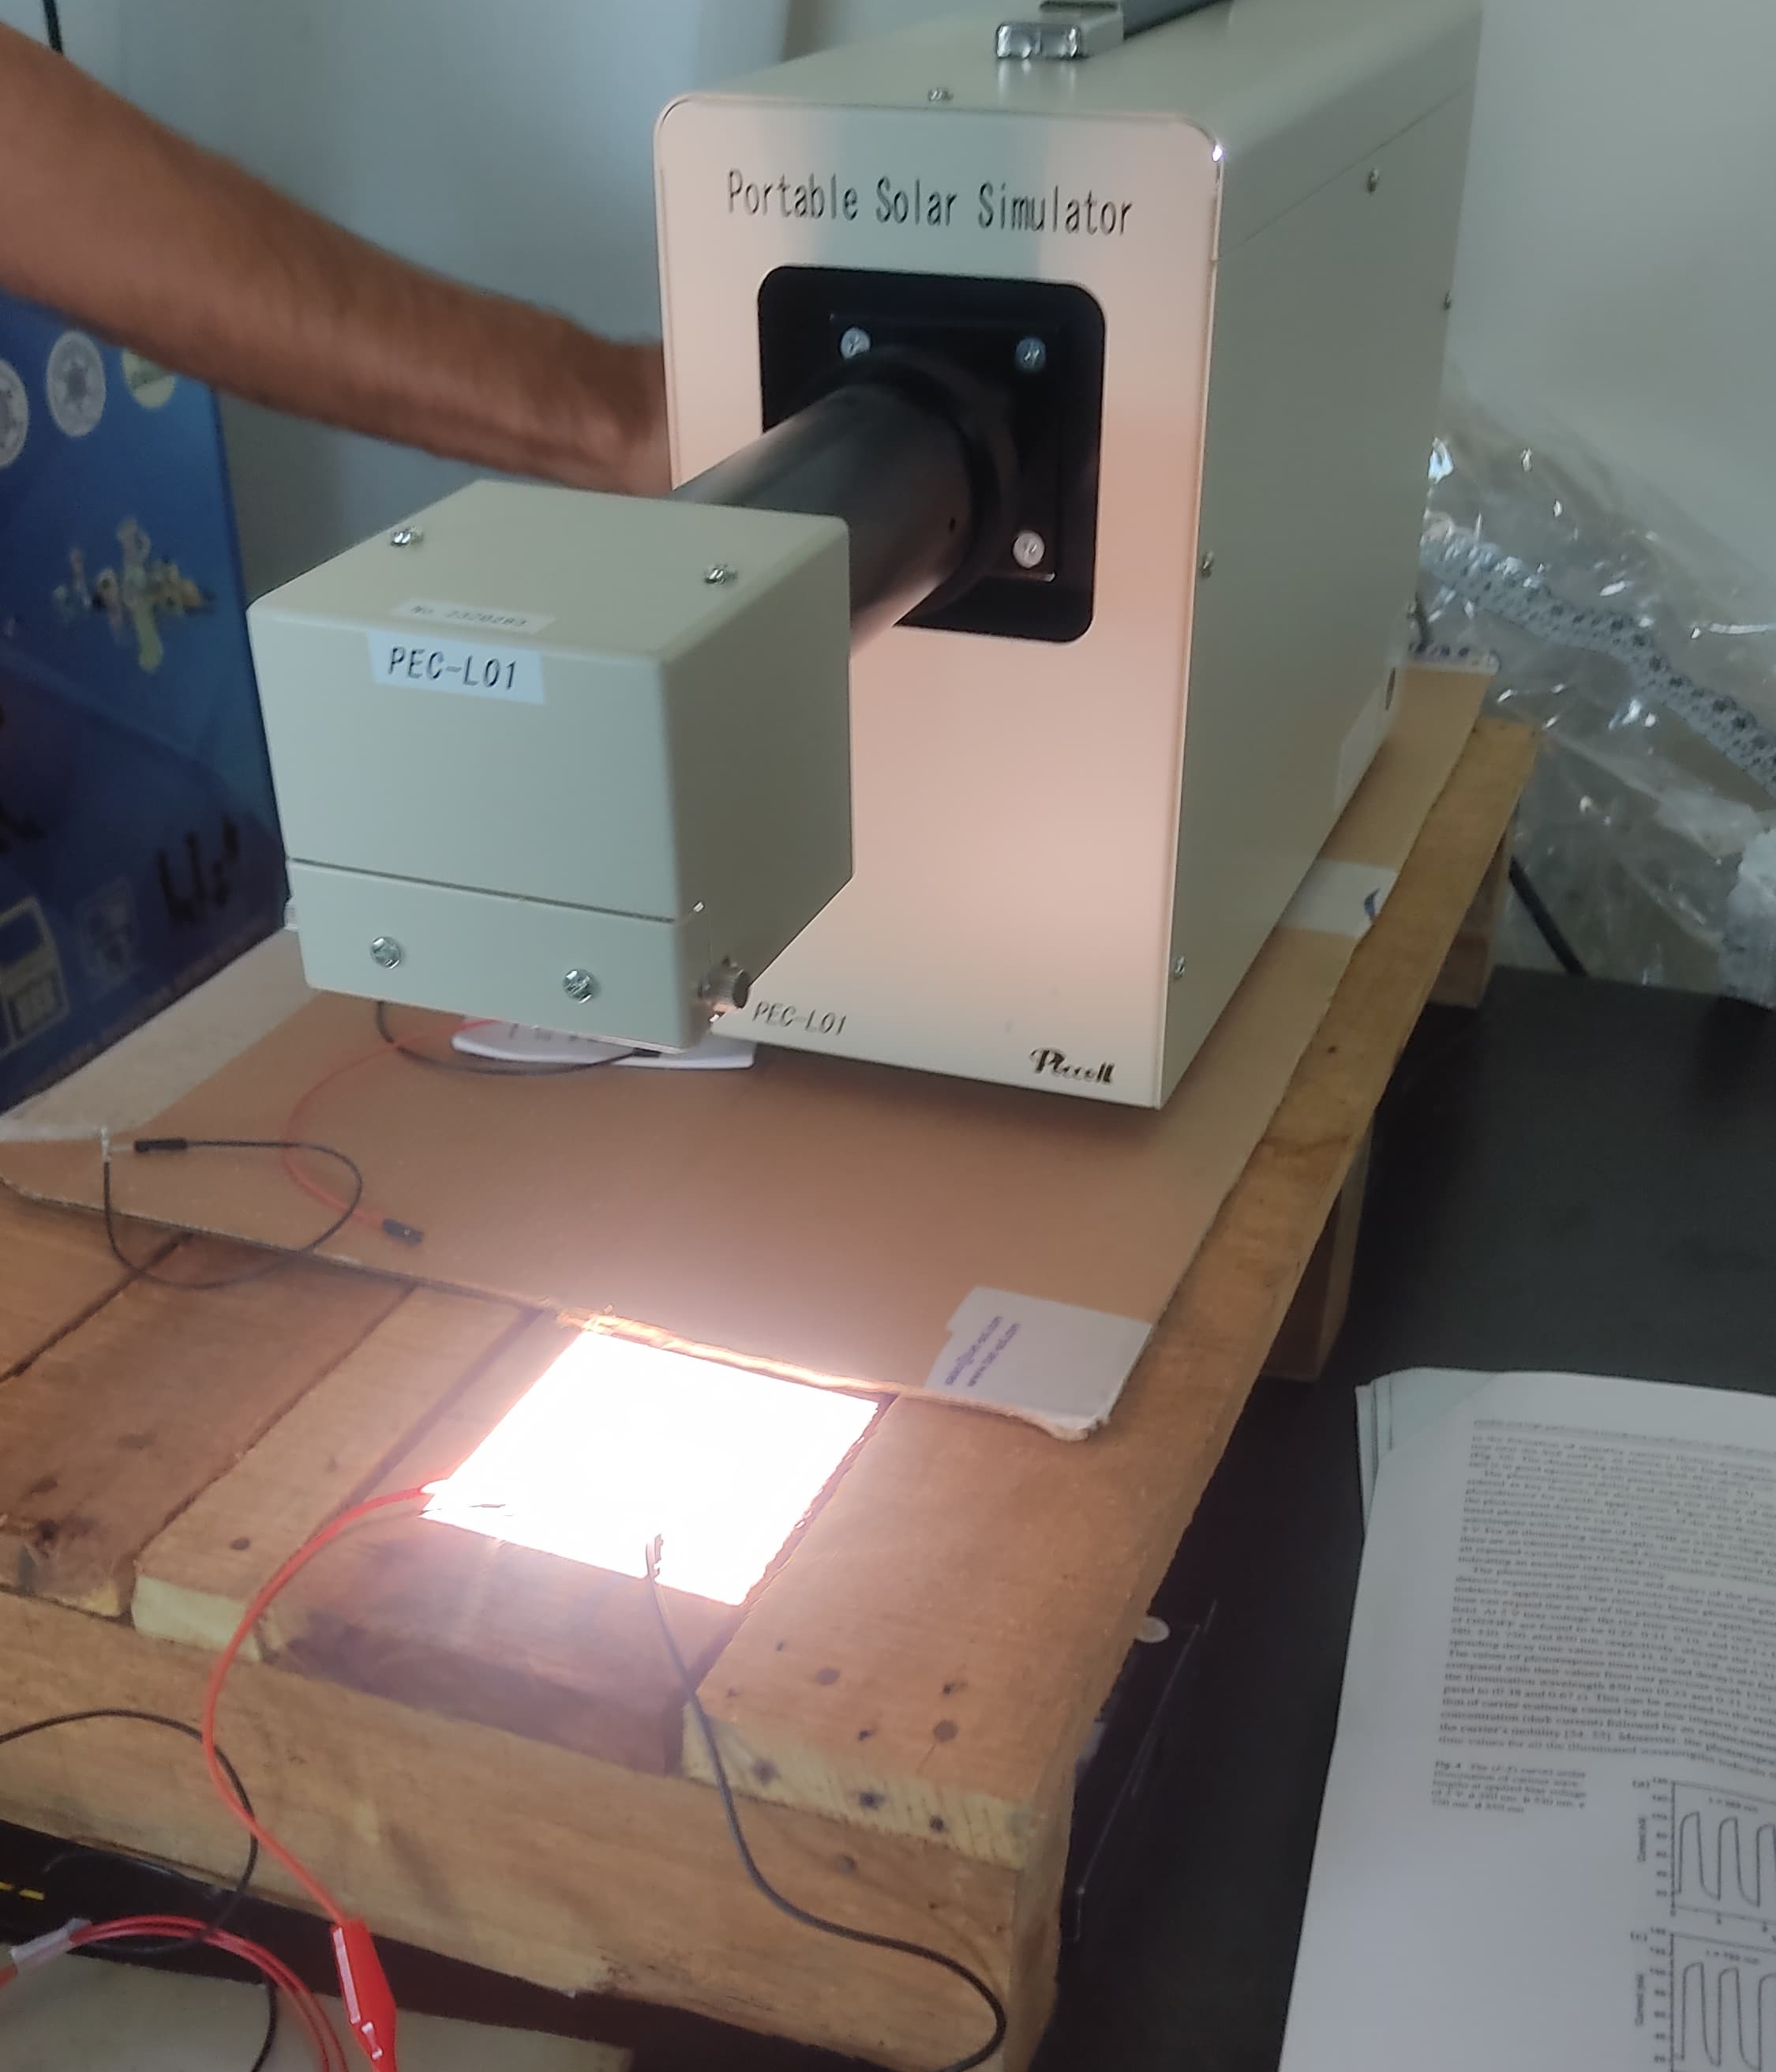
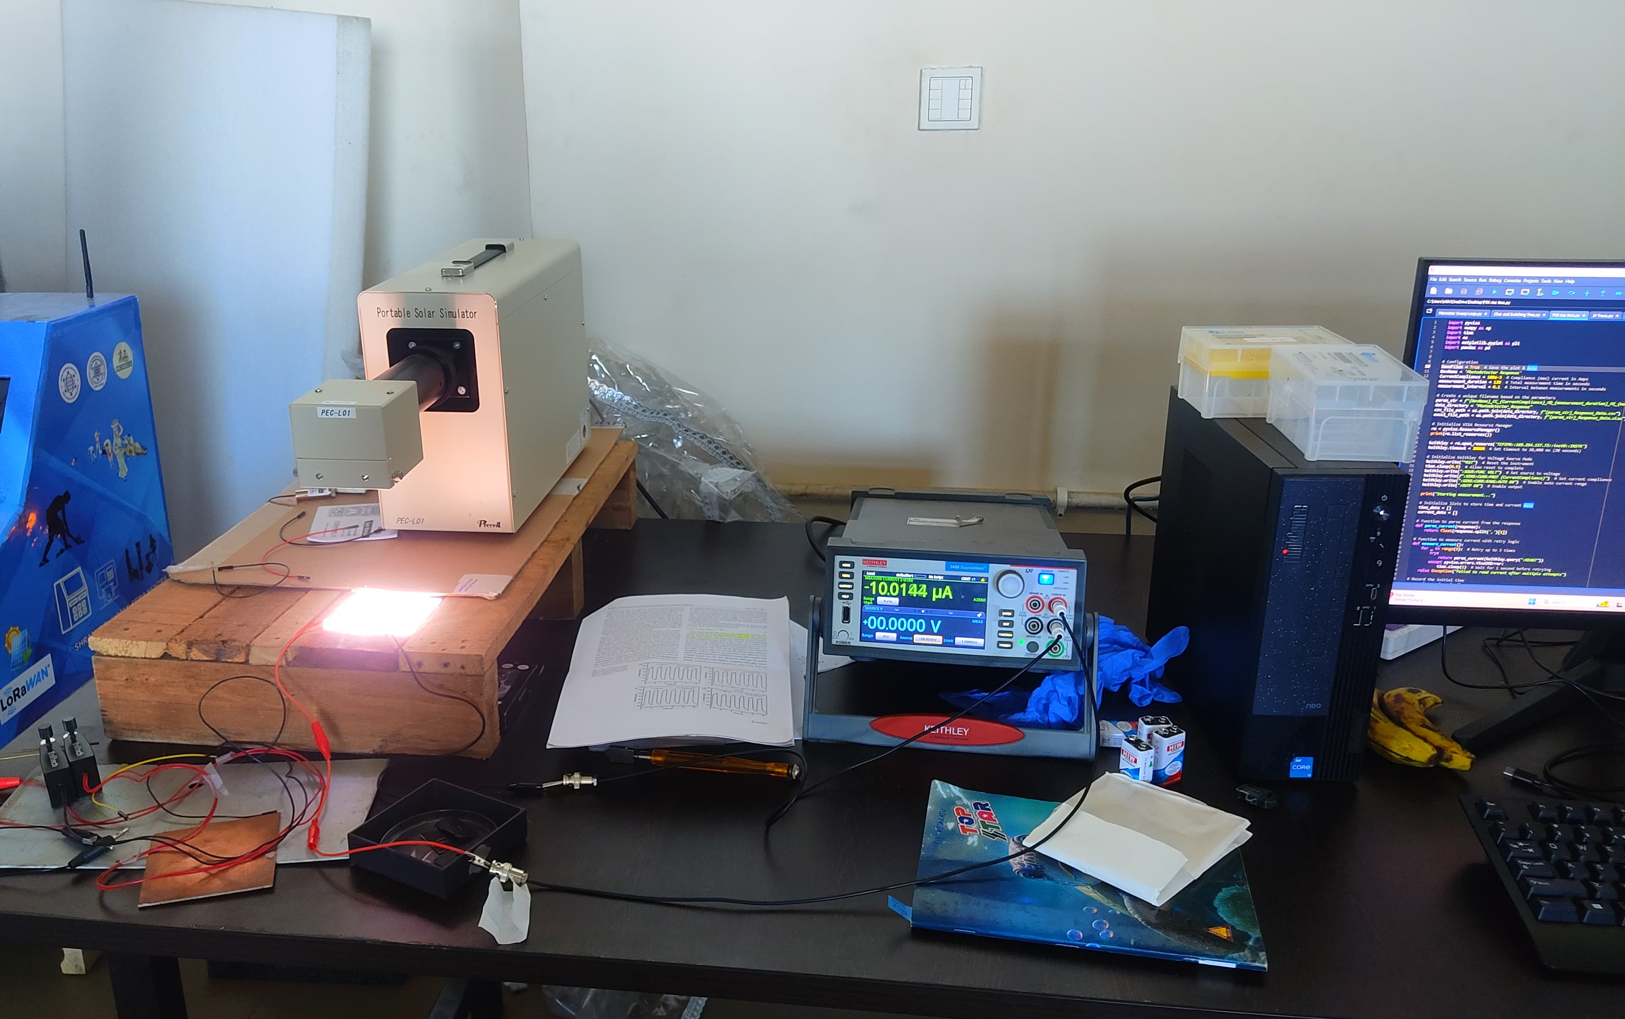
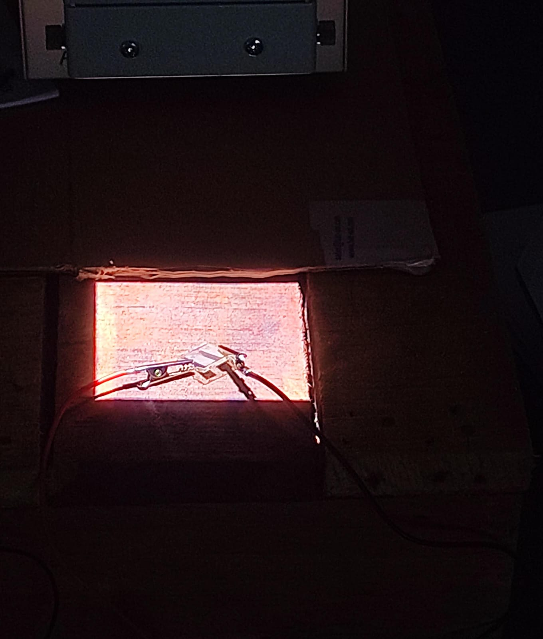
V-I Characteristics and Analysis
The Characterization is performed Using Monochromatic Light.
I-V characteristics measured under light and dark illuminated conditions.
Device shows clear photoconductive behavior.

Slide 21
V-I Characteristics and Analysis
CURRENT(mA }
The I–V graph shows strong photocurrent under illumination and low, linear dark current, highlighting the SnS photodetector’s high light sensitivity and suitability for optoelectronic applications.

Slide 22
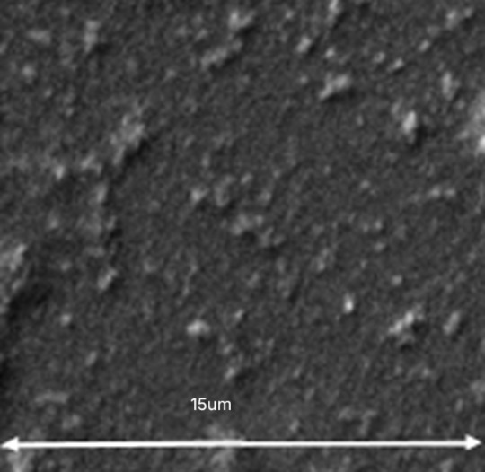
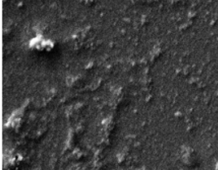
25um
The SEM images show the surface morphology of a SnS thin film deposited on an FTO glass substrate for a photodetector device. Silver is used for metal contacts. The film appears dense, uniform, and finely granular with slight nanoscale roughness. The presence of minor agglomerates, which may influence the optoelectronic performance.

Slide 23
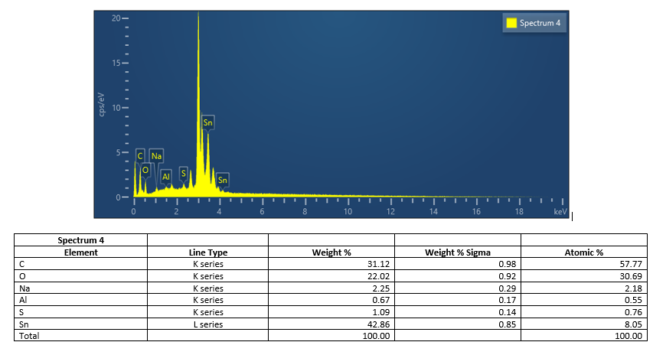
The EDX analysis confirms the presence of Sn and S in the thin film, verifying the formation of SnS. Tin shows the highest weight percentage (42.86%), with traces of O, C, Na, and Al also detected. These may originate from surface contamination or the substrate, while the strong Sn and S signals confirm successful material deposition.
Intensity cps/eV
Energy (keV)

Slide 24
Conclusion

Slide 25
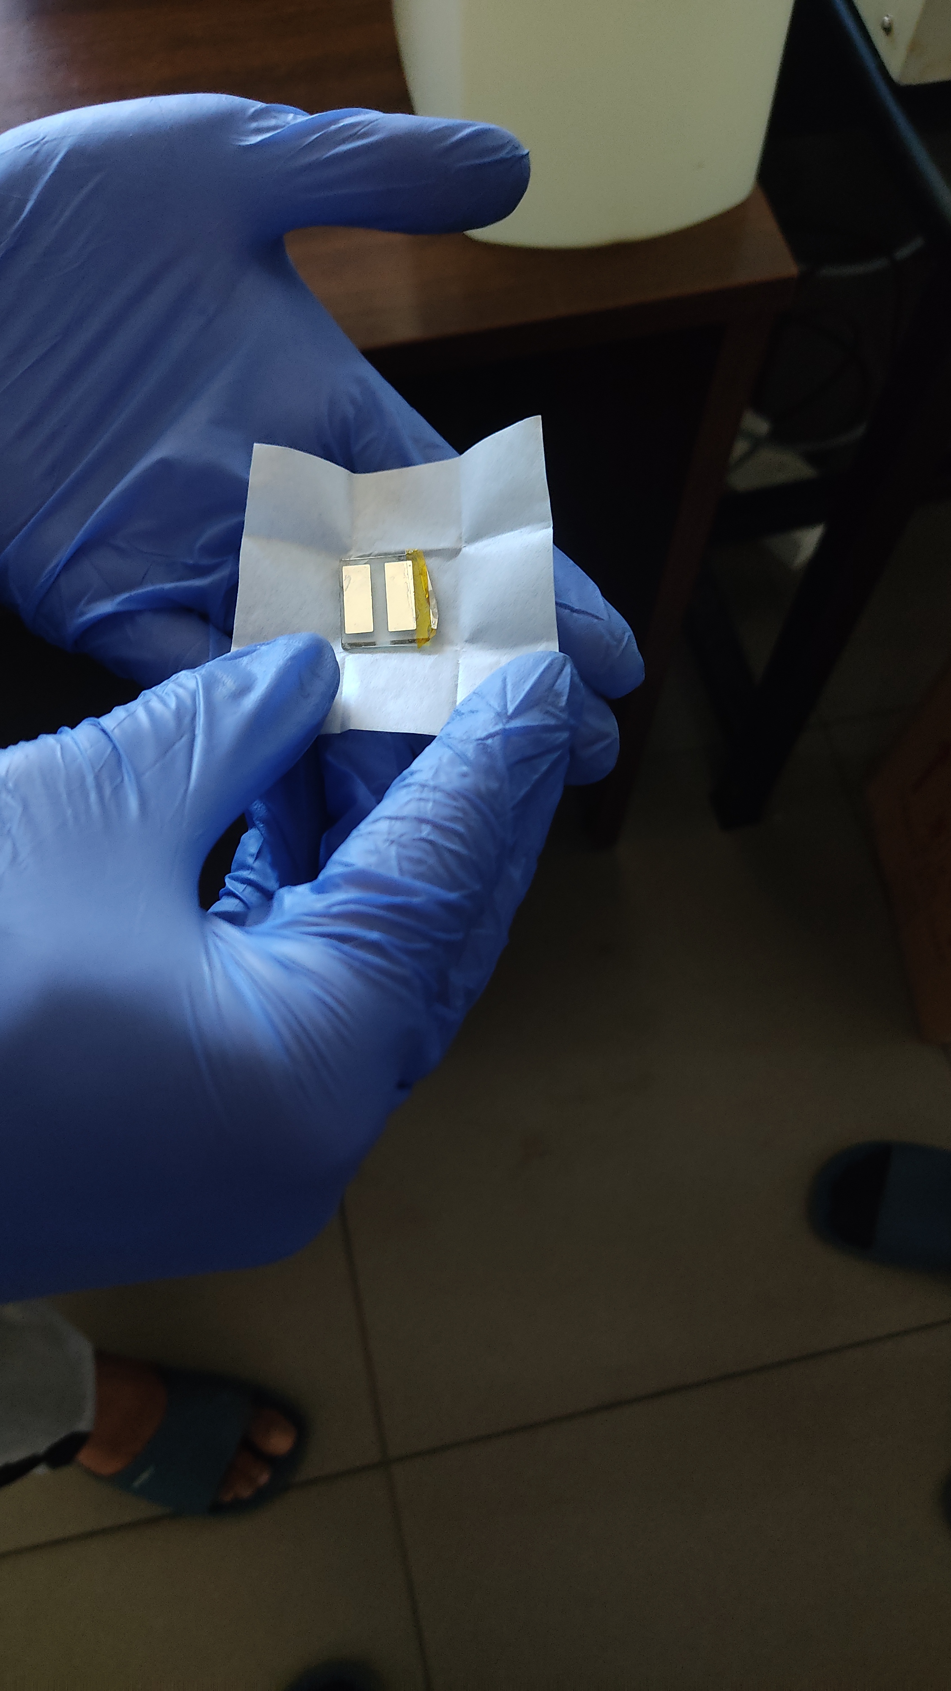
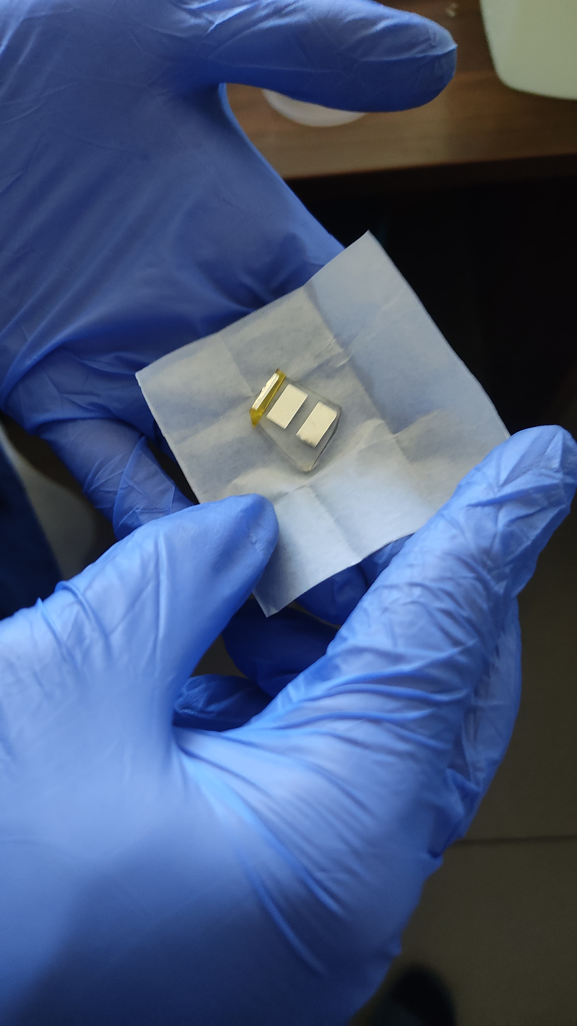
Conclusion
Successful fabrication of SnS-based photodetector on FTO substrate.
EQE and responsivity showed strong performance in the visible range.
Monochromatic exposure confirms spectral selectivity.
Spin coating and thermal evaporation play key roles in determining device efficiency.
Future work may involve optimizing thickness, annealing temperature, or doping.

Slide 26
References
Josephine, EgwuJ. Zhang et al., "High Sensitivity Photodetector Development," Opt. Express, vol. X, no. Y, pp. XX-XX, Jan. 2025.
S. Kumar et al., "Nanostructured Photodetector Materials," IEEE Photonics Journal, vol. Z, no. W, pp. YY-ZZ, Feb. 2025.
Salah Abdo, Khalil As’ham, Ambali Alade Odebowale, Sanjida Akter, Haroldo Hattori, Andrey E. Miroshnychenko, “A Near-Ultraviolet Photodetector Based on the TaC: Cu/4 H Silicon Carbide Heterostructure”, Advanced Materials, Applied Sciences
Nyenga N., Okunzuwa S. Ikponmwosa and Imosobomeh L. Ikhioya. “Synthesis of SnS/SnO Nanostructure Material for Photovoltaic Application.” European Journal of Physics (2023)
Groussin, Baptiste, M. Martinez Calderon, B Marsh and Eduardo Granados. “Simulation of Plasmonic Effects in Nanostructured Copper Surfaces for Field-assisted Photoemission.” Journal of Physics: Conference Series 2687 (2024): n. pag.
Gladyshev, S., Pashina, O., Proskurin, A., Nikolaeva, A., Sadrieva, Z., Bogdanov, A., Petrov, M., & Frizyuk, K. (2023). Fast simulation of light scattering and harmonic generation in axially symmetric structures in COMSOL. arXiv (Cornell University).

Slide 27
Hui, Datai, Shun Zhou, Chang-long Cai, Shigeng Song, Zhentao Wu, Jian Song,, Bo Lu, Yingbu Duan. “Modeling and Experimental Investigations of Nanostructured Ag Thin Films Produced by Oblique-Angle Deposition and Its SERS Performance.” Coatings 11 (2021): 458.
Mohamed S. Mahdia,, Naser M. Ahmed “Comprehensive photoresponse study on high performance and flexible π- SnS photodetector with near-infrared response” Materials Science in Semiconductor Processing 100 (2019) 270–274
Zbigniew BIELECKI , Krzysztof ACHTENBERG ” Review of photodetectors characterization methods” Bulletin Of The Polish Academy Of Sciences ,Technical Sciences, Vol. 70(2), 2022, Article number: e140534 ,DOI: 10.24425/bpasts.2022.140534
Mohamed S. Mahdi · Husam S. Al‐Arab“Flexible and high‐performance broadband nanofowers tin sulfde photodetector” Applied Physics A (2020) 126:958 https://doi.org/10.1007/s00339-020-04144-7
Yourong Tao, Xingcai Wu” Flexible photodetector from ultraviolet to near infrared based on a SnS2 nanosheet microsphere film” DOI: 10.1039/c4tc02325k
Xing Zhou, Qi Zhang “Large-Size Growth of Ultrathin SnS2 Nanosheets and High Performance for Phototransistors” © 2016 WILEY-VCH Verlag GmbH & Co. KGaA, Weinheim DOI: 10.1002/adfm.201600318

